Slide 1
Payroll System
Prepared By: Guided By:
AISHWARYA TRIVEDI ALAUKIKA MATHU

Slide 2
Agenda
Project defination
Need for the new system
Proposed system
Features
Contex Level diagram
System Flow diagram
Screen Shots

Slide 3
PROJECT DEFINATION
This system is useful for the Account Department(administrator) of the Company. By this the accentuating department of the company effortlessly able to generate employee payment slip.
With the help of this intranet Payroll System admin can easily enter the new employee and assign wage to the employee. As well as they can edit or update the employee entry and wage assign to the employee.

Slide 4
Need for the new system
Editing of the data tedious job.
Several manual task leads to the unnecessary burden to the administrator and waste more time.
No security features in existing system.
Time-consuming pay-slip generation.
Problem in calculating income-tax and amount related loans.
Hard to maintain register.

Slide 5
Proposed System
After computerizing the system, the owner of the organization or the admin of the system can finish their work in least amount of time and efforts.
The admin here have to see the current employee and their salary rate of the particular perks and deduction as there are constant fluctuations in the deductions.
All the work done is automatically and the system itself is capable to calculate the Monthly Salary as per their attendance.

Slide 6
Continue..
This system helps the admin by providing the accounting details of the current time period and also provides the facility of producing the monthly reports.
The new system will have the facility to sort data according to any specific type on the basis of what the employee wants in any order.
Also with the help of this system if the employee wants to access any their data from many employees data he/she can automatically get the desired data.

Slide 7
Features
Maintain Perks and Allowance Details.
Removal of Data Redundancy.
Data Consistency.
Monthly Payslip.
Attendance Details etc.
Data security.

Slide 8
Continue..
User friendly.
Complete solution for employee salary handling.
Quick response to queries.
Reduce the laborious work.
Maintenance of is easy.
Provide accurate and relevant information.
Timely generation of Reports.
Enhanced data integrity.

Slide 9
Context Level Diagram

Slide 10
System Flow Diagram

Slide 11
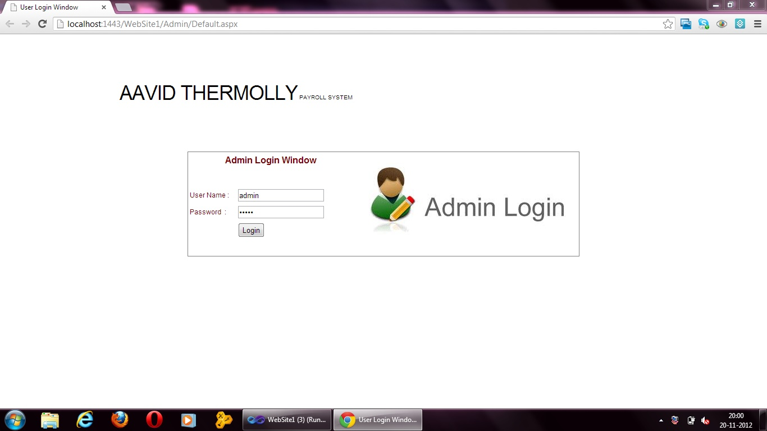
Screen Shots Admin Login:

Slide 12
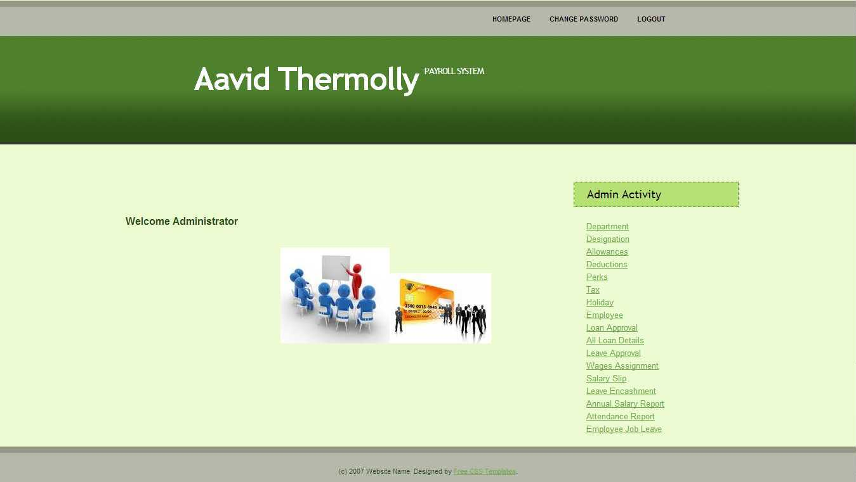
Admin Home:

Slide 13
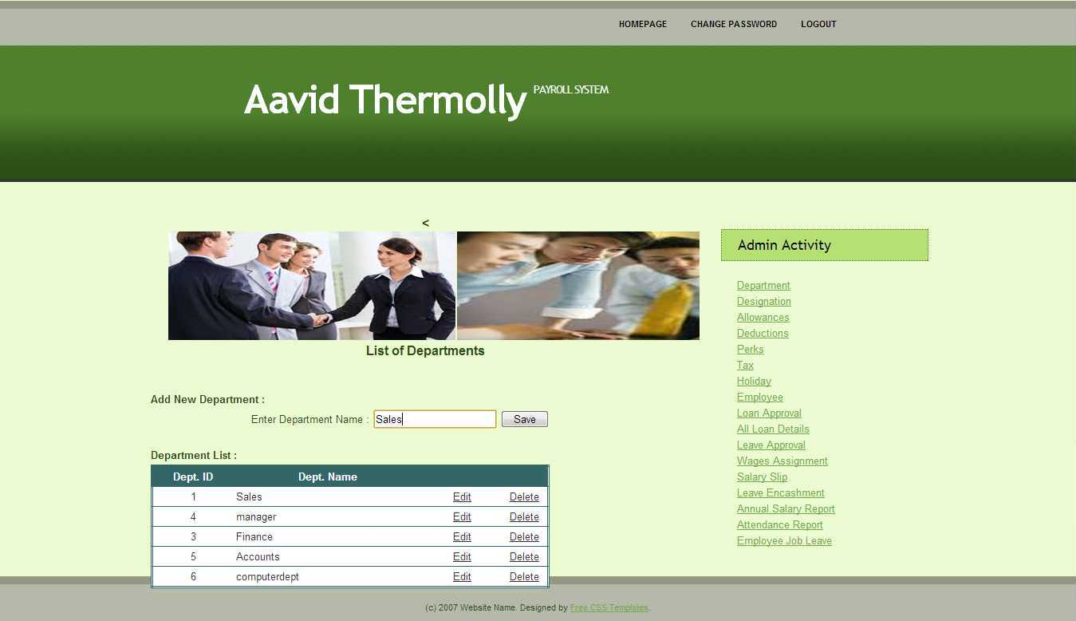
Department:

Slide 14
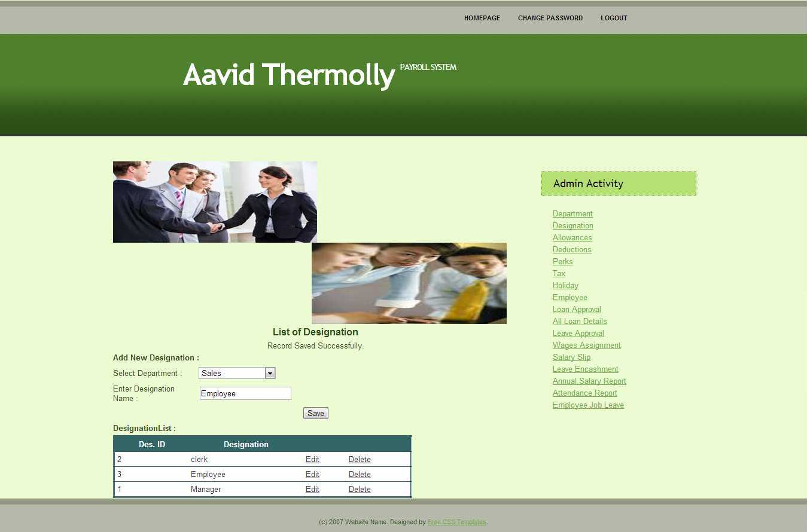
Designation:

Slide 15
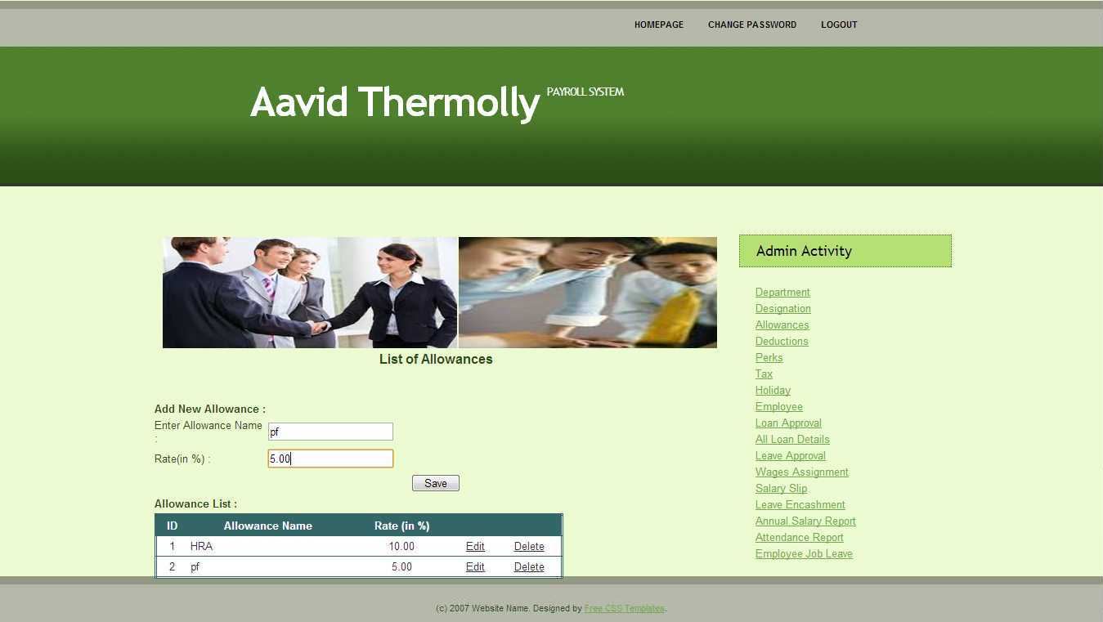
Allowance:

Slide 16
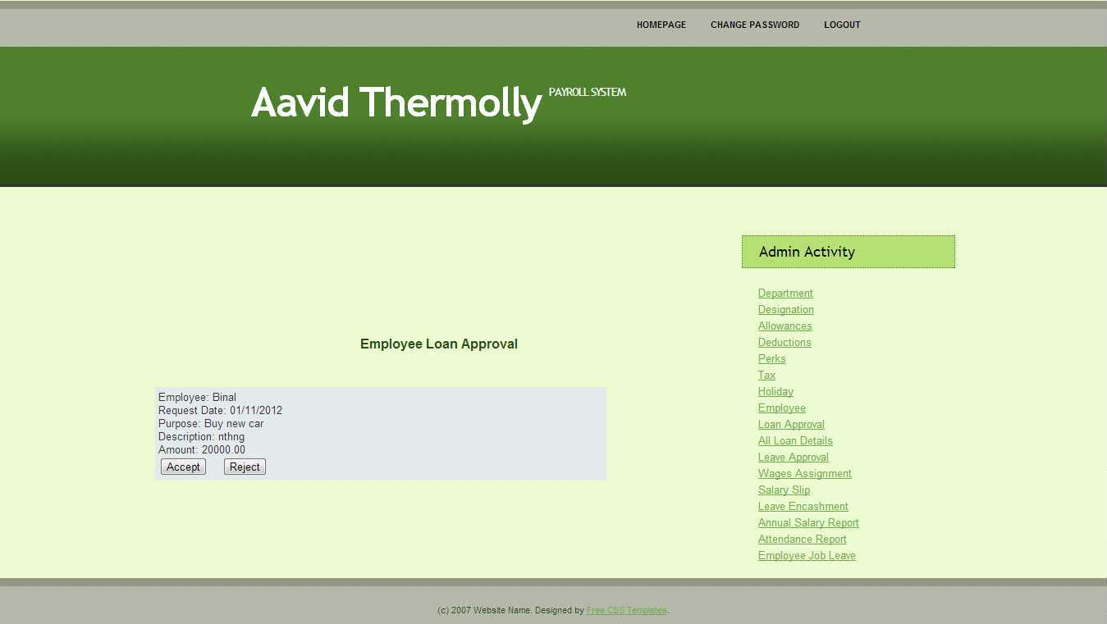
Loan:

Slide 17
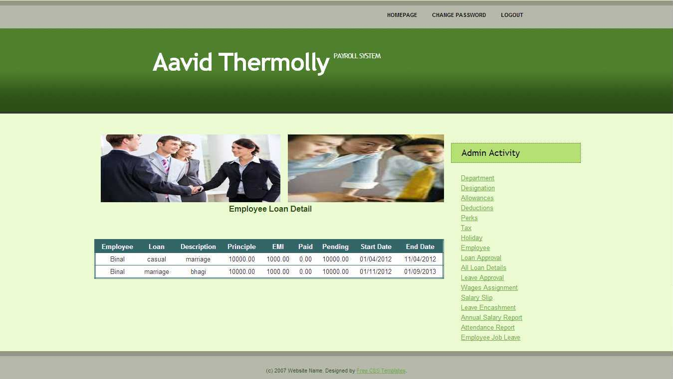
Loan Detail:

Slide 18
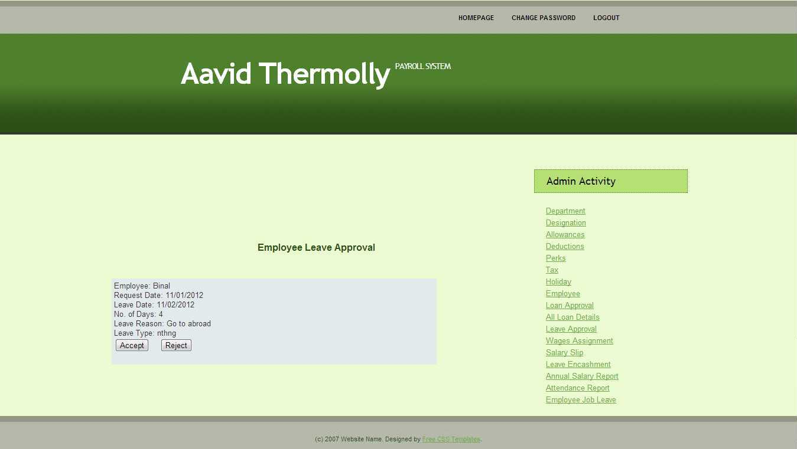
Leave Approval:

Slide 19
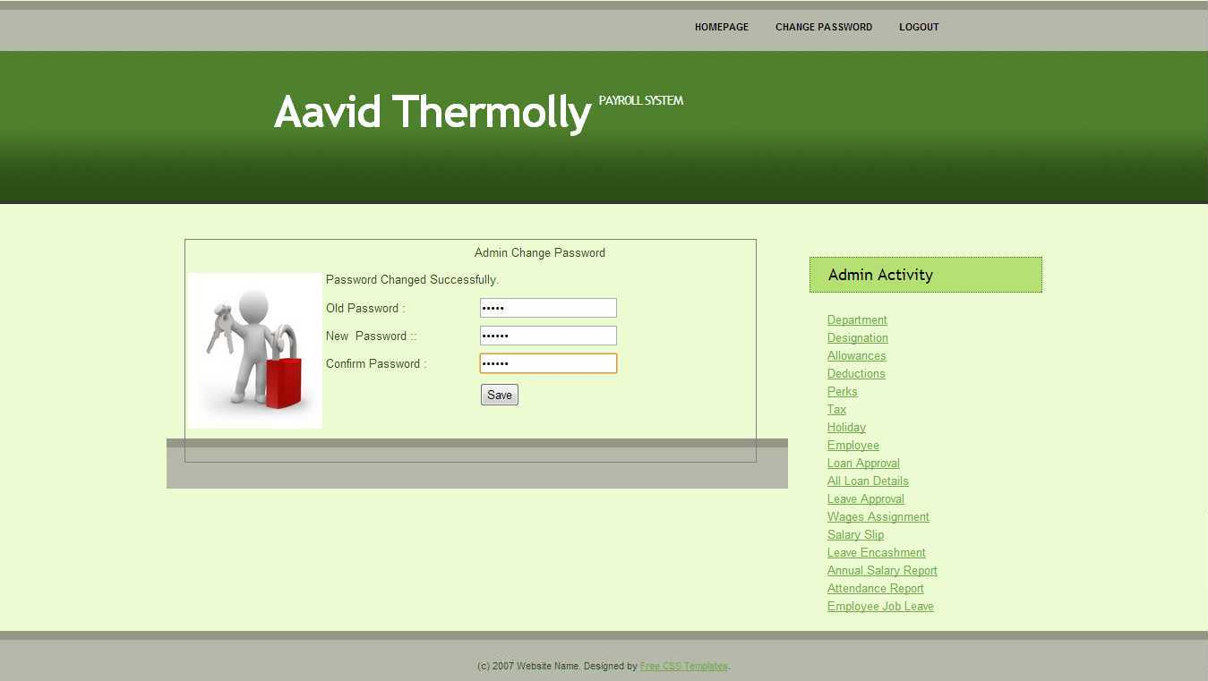
Change Password:

Slide 20
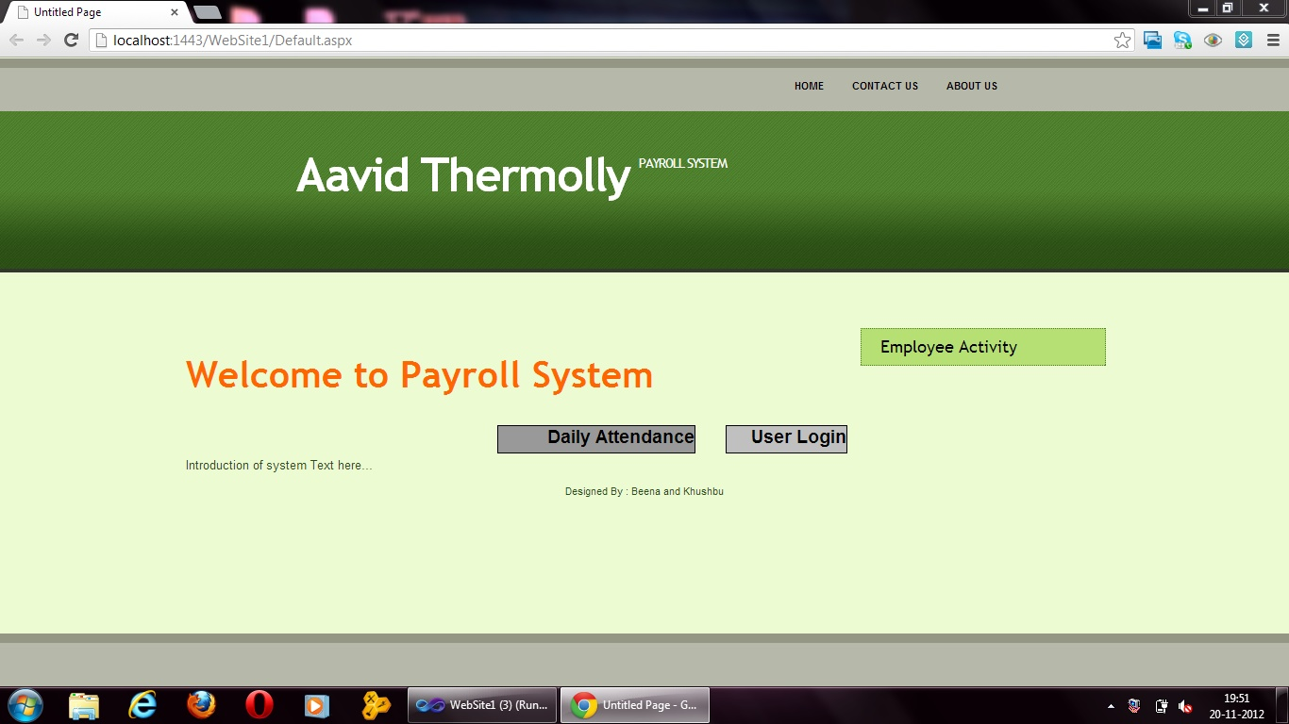
Employee Home Page:

Slide 21
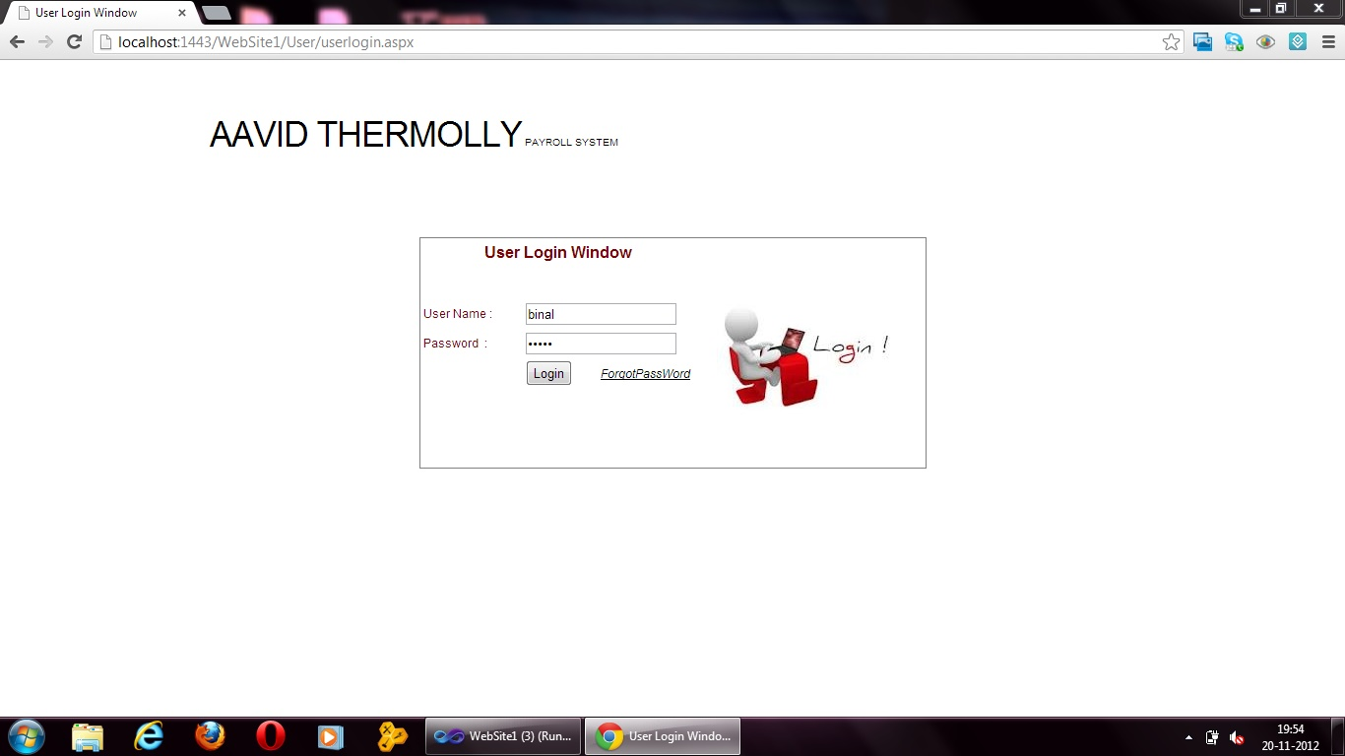
Employee Login:

Slide 22
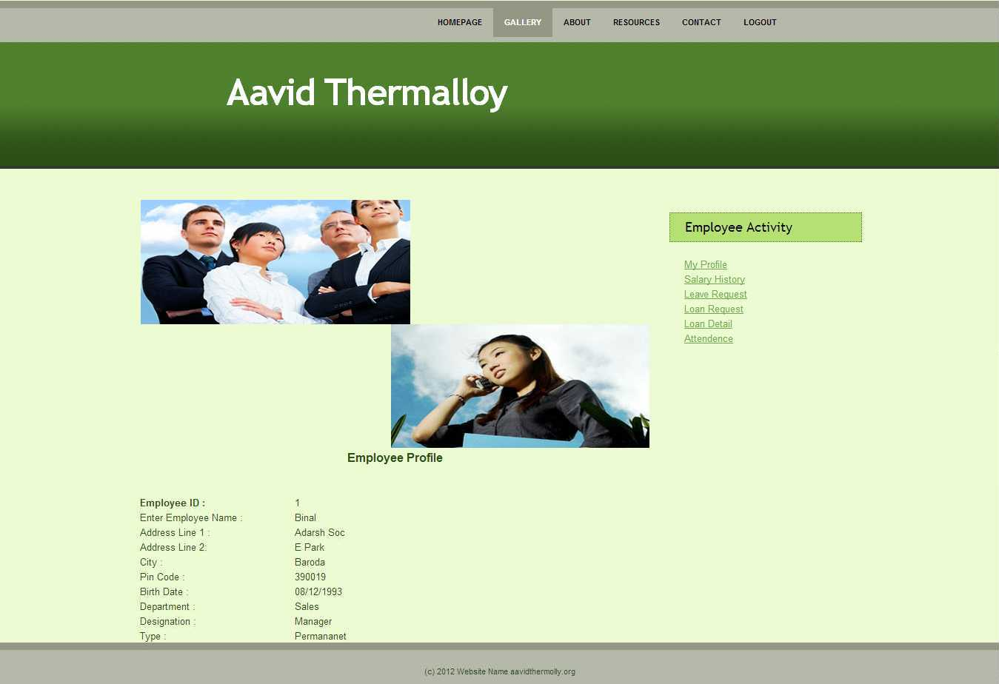
Employee Profile:

Slide 23
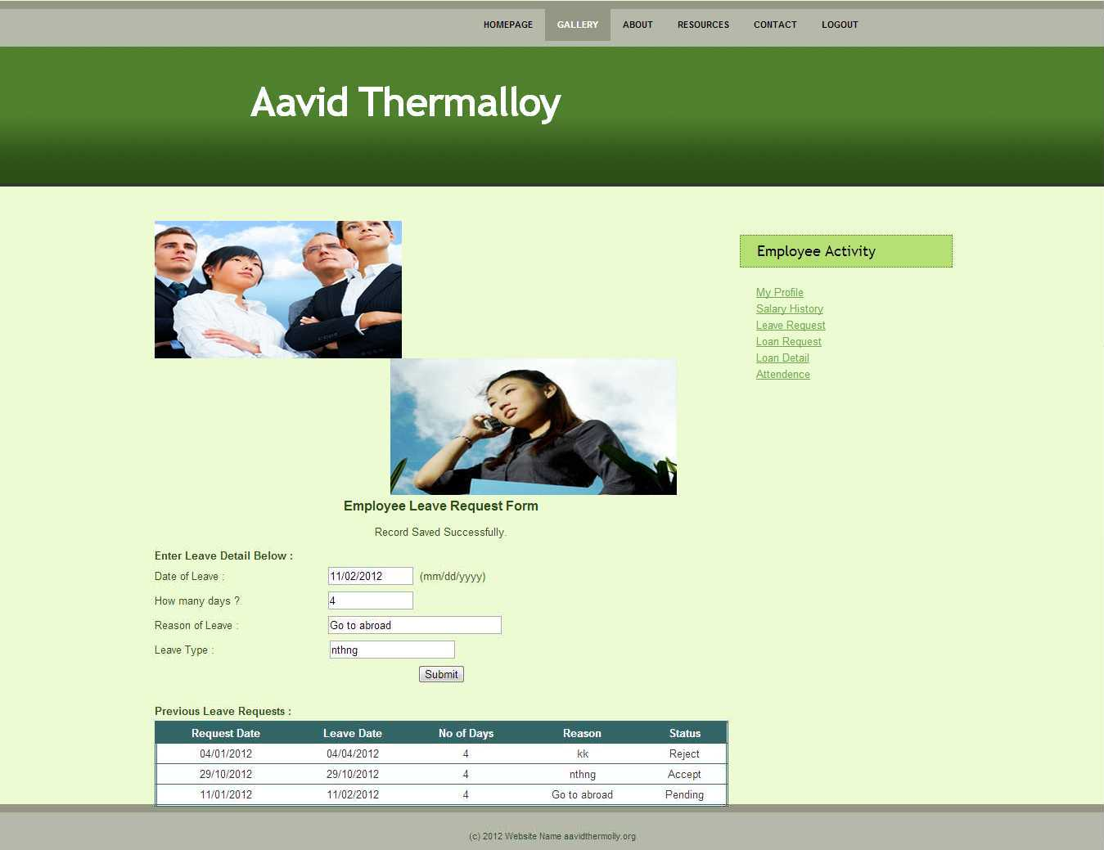
Employee Request For Leave:

Slide 24
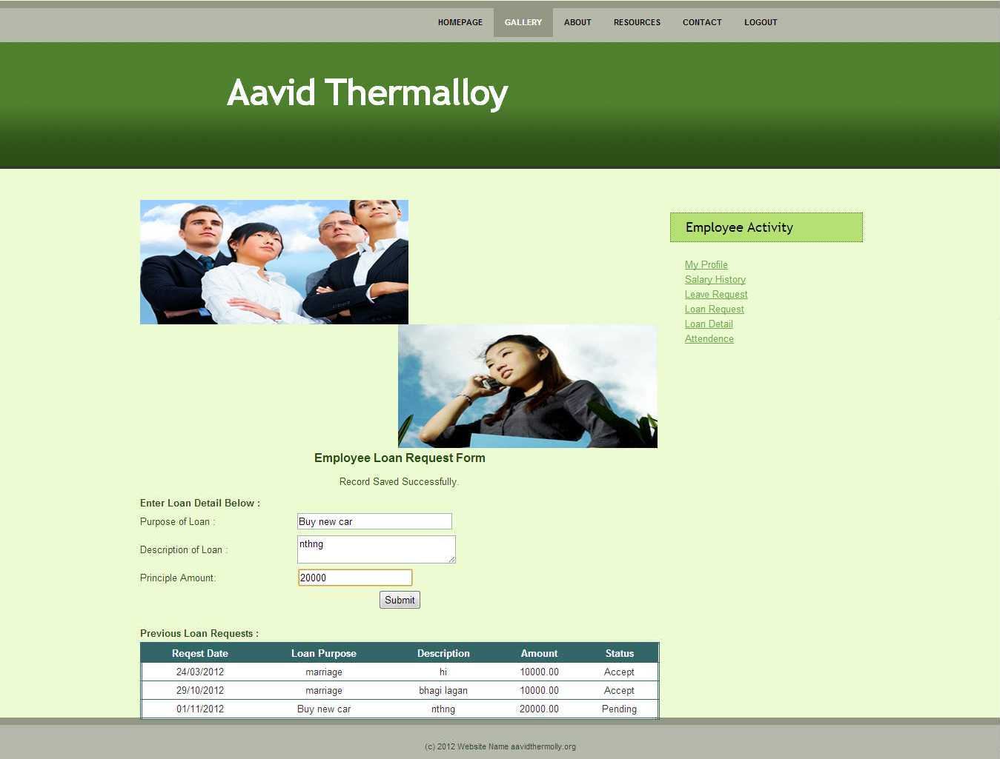
Employee Request For Loan:

Slide 25
Limitation
Multi-time wrong user id and password is entered the system and never generate Multi-time password error.
Want to search Field or another searching method, then system have no advance search concept.
For loan report admin will not able to view individual employee loan report.
Security at admin side without any encryption method
Backup and restore method is not available.

Slide 26
Future Enhancement
Developing the system in proper designing format.
For handling the system user must be trained
Maintain the system periodically
Allow overtime and shift wise calculation.
Hour counting is also possible in new version.

Slide 27
Conclusion
From this project work we have got the practical experience where the business applications works and the efficiency and skill level required to cope-up with the movement in I.T. development switch is fast growing in the business areas.

